Slide 1
Machine Learning using Orange
Xiaojuan Zhu(Julia)
The University of Tennessee, Knoxville
Office of Innovative Technologies
2309 Kingston Pike, KPB Suite 132
Knoxville, TN 37996
HelpDesk: 974-9900
http://oit.utk.edu/research

Slide 2
RCS Support
RCS typically helps UT researchers with:
Statistical consulting
Research design and implementation
Data collection strategies including; developing interview guides, and survey construction
Data analysis using qualitative, quantitative, and GIS methods
Provide specialized research software support services including:
Installation and licensing
Akindi exam scoring
Call OIT helpdesk: 865-974-9900

Slide 3
What is Orange
Orange is a data mining software created and developed by the Bioinformatics Laboratory at the University of Ljubljana (not a commercial software).
It can be used for developing and testing machine learning models as well as conducting exploratory data analysis and visualization.
Orange’s components are widget-based and allow user drag and drop to a canvas.
You can download and install Orange from the link here, https://orangedatamining.com/download/

Slide 4
Why is Orange?
It is easy to implement the machine learning models.
It is rich visualizations and interactive models.
Wiki says, Orange is “a visual programming front-end for exploratory qualitative data analysis and interactive data visualization.”
No need to learn Python programing to analyze the data.
Orange has many add-on toolboxes such as Bioinformatics, Timeseries, Survival analysis, Text and Spectroscopy.
It is open-source platform and FREE.
Notes:
This workshop foruses on how to implement machine learning in orange. What is the difference between KNIME and oragne

Slide 5
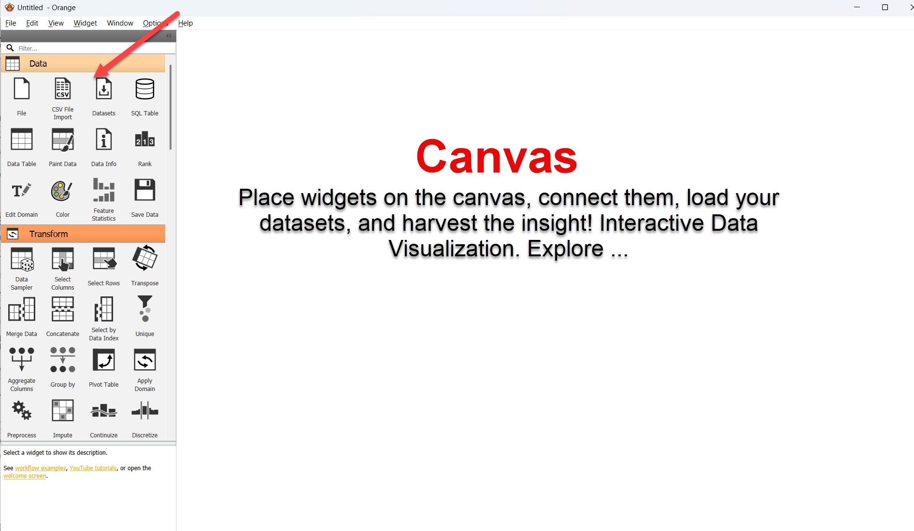
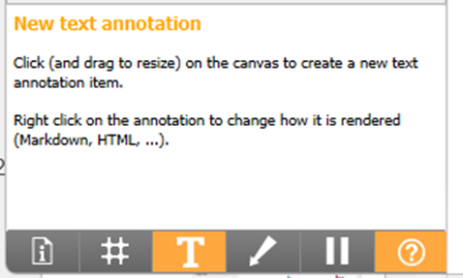
User interface
Widget Catalog
· Data · Transform · Visualize · Model · Evaluate · Unsupervised ·Educational · other add-ons

Slide 6
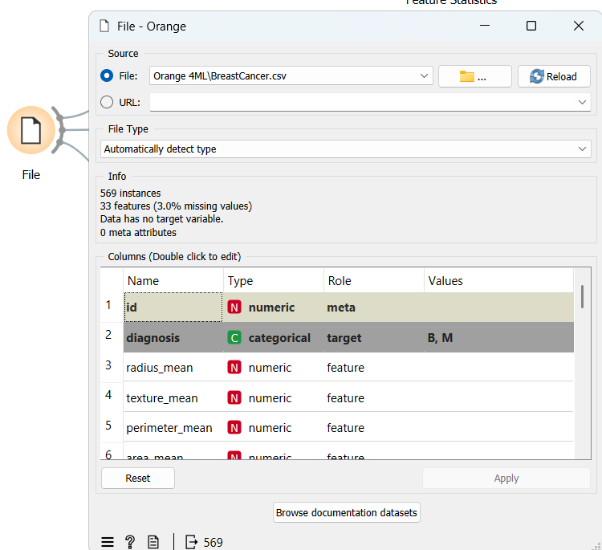
Import data
File widget to import a dataset on your local drive or online using URL.

Slide 7
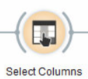
Import data
The data feature can be defined here as well. Diagnosis is set as the target variable. ID can be set as meta.
Role: features, target, meta.
Note: Meta variables are meta data, data about data, not used for statistical inference.
Features can also be defined
at Select Columns Widget

Slide 8
Breast Cancer Data
Features are computed from a digitized image of a fine needle aspirate (FNA) of a breast mass. They describe characteristics of the cell nuclei present in the image. A few of the images can be found at http://www.cs.wisc.edu/~street/images/. The mean, standard error, and "worst" or largest (mean of the three largest values) of these features were computed for each image, resulting in 30 features:
Target variable:
diagnosis: M for malignant, B for benign – Acts as the ‘Target’
area: tumor area – Acts as the ‘Target’ or Response for Example2
Features:
radius: distances from center to points on the perimeter
texture: standard deviation of gray-scale values
perimeter: tumor perimeter
smoothness: local variation in radius lengths
compactness: perimeter^2 / area - 1.0
concavity: severity of concave portions of the contour
concave points: number of concave portions of the contour
symmetry: measure of tumor symmetry
fractal dimension: "coastline approximation" – 1
Data source: https://archive.ics.uci.edu/dataset/17/breast+cancer+wisconsin+diagnostic.
Notes:
I will use the same data as KNIME workshop. So we can compare two software’s performance. The two workshop’s goal is to compare two software’s performance on ML models.

Slide 9
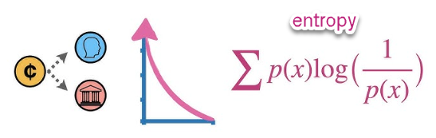
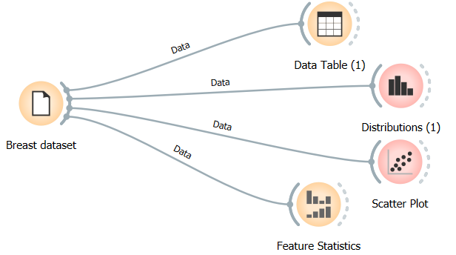
Describe the data
Two way to find a widget:
Drag widget from the widget catalog
Drag a line from the file widget the widget options will be shown automatically
Data table: View the Data
Distribution: Plot the histogram
Scatter plot: show x by y scatter plot
Feature statistics: Dispersion (Coefficient of variation-CV for numeric data and entropy for categorical data)
Other features: box plot, violin plot, line plot, bar plot, heat map and etc.
Notes:
information entropy is the average amount of information conveyed by an event, when considering all possible outcomes.

Slide 10
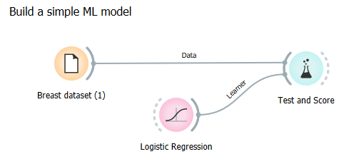
Fit a simple ML model
Fit a logistic regression model
Data file and logistic regression widget are both connected to test and score.
Notes:
Thank you!
Got Questions?

Slide 11
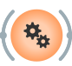
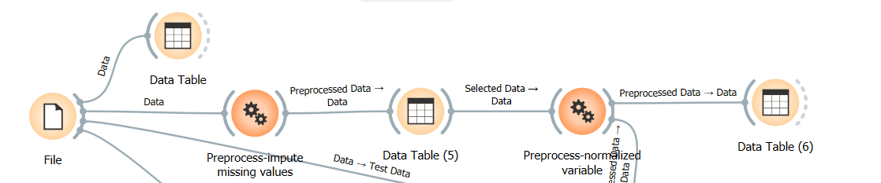
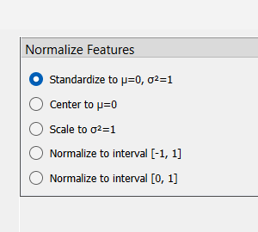
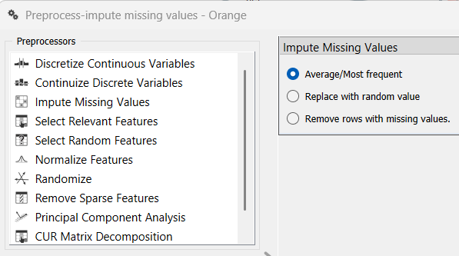
Preprocess widget
Missing values imputation
Rescale the data
Notes:
Thank you!
Got Questions?

Slide 12
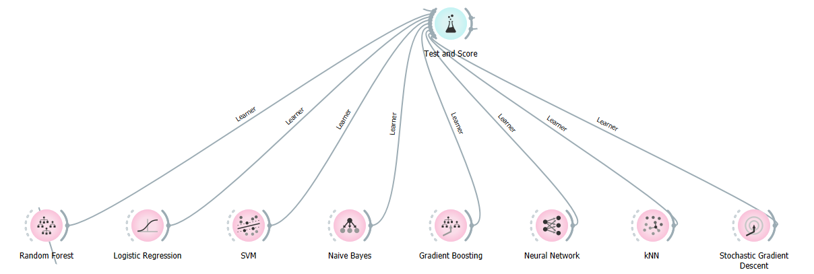
Fit ML models
All the models can be dragged to the canvas and connected to Test and Score
Notes:
Thank you!
Got Questions?

Slide 13
Fit ML models
Random Forest – An ensemble model that builds multiple decision trees and combines their predictions to improve accuracy and control over-fitting. The model also called classifier or learner in Orange and Sklearn.
Logistic Regression – A logistic regression that includes a regularization term to prevent overfitting by penalizing large coefficients generated my collinear features/independent variables. Note that regularization is applied by default.
Support Vector Machines (SVM) – A model that finds the optimal hyperplane to separate data points into different classes with the maximum distance in a high dimensional space.
Naïve Bayes – A model works only with discrete attributes. By default, continuous attributes are discretized.
Gradient Boosting (XGBoost) – An ensemble model that builds multiple sequential trees, each correcting errors of previous ones to achieve higher predictive accuracy. (See here)
Notes:
Thank you!
Got Questions?

Slide 14
Fit ML models
K-Nearest Neighbors – A model assumes that similar things exist in close proximity. In other words, similar things are near to each other.
Neural Network Algorithm – A model simulates human brain by weighting “neurons” stored in “hidden layers“. Each training observation adjusts the impact of each neuron, often through ”back-propogation”. Deep Learning uses many layers and many neurons per layer. Multi-layer Perceptron (MLP) classifier – this model optimizes the log-loss function using LBFGS or stochastic gradient descent.
Stochastic Gradient Descent – A model uses stochastic gradient descent that minimizes a chosen loss function with a linear function. The algorithm approximates a true gradient by considering one sample at a time, and simultaneously updates the model based on the gradient of the loss function.
(See here)
Notes:
Thank you!
Got Questions?

Slide 15
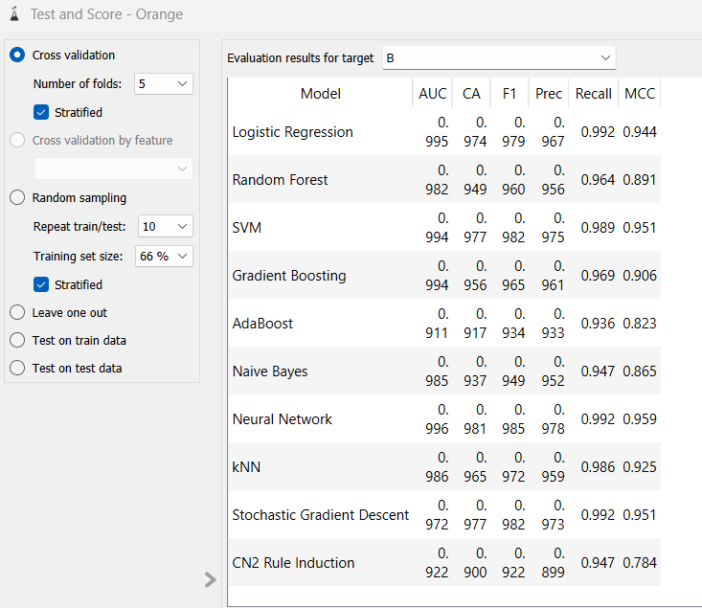
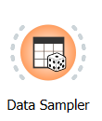
Model Evaluation
Test and scoring
Cross validation: splits the data into a given number of folds (usually 5 or 10) and tested by holding out examples from one fold at a time; the model is induced from other folds and examples from the held out fold are classified. This is repeated for all the folds. KNIME uses meta nodes.
AUC: Area Under Curve
Classification accuracy (CA): Accuracy
Matthews correlation coefficient (MCC) : an MCC score closer to 1 indicates better classifier performance, while a score closer to -1 suggests poor performance. In practice, an MCC score above 0.3 is considered moderate, and a score above 0.5 is considered strong.
Data Sampler: split the data into training and testing
Notes:
It is splits the data into a given number of folds (usually 5 or 10). The algorithm is tested by holding out examples from one fold at a time; the model is induced from other folds and examples from the held out fold are classified. This is repeated for all the folds

Slide 16
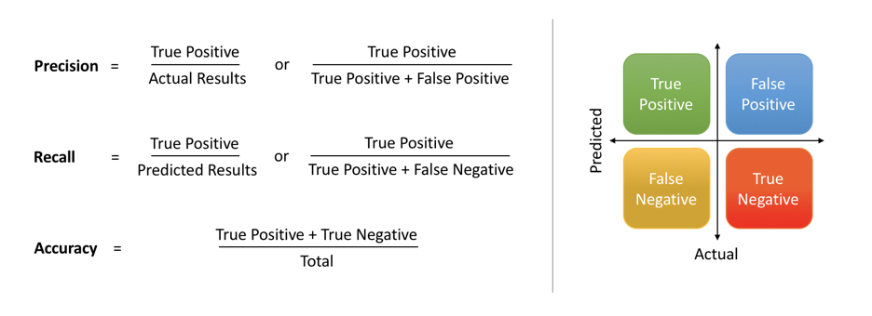
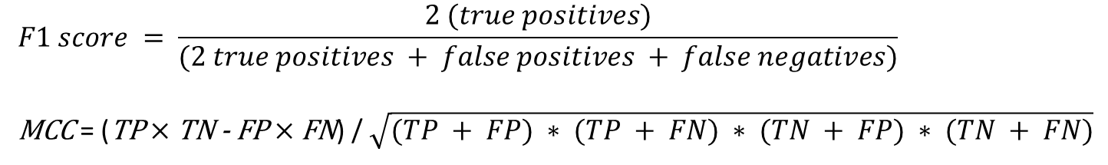
Test and Score – Model Evaluation
$$F1 score = \frac{2 (true positives)}{(2 true positives + false positives + false negatives)}$$
MCC = (TP $×$ TN - FP $×$ FN) / $\sqrt{(TP + FP) ∗ (TP + FN) ∗ (TN + FP) ∗ (TN + FN)}$
Notes:
The F1 score is a measure of a test’s accuracy. It considers both the precision and the recall of the test to compute the score. The F1 score can be interpreted as a weighted average of the precision and recall, where an F1 score reaches its best value at 1 and worst at 0.

Slide 17
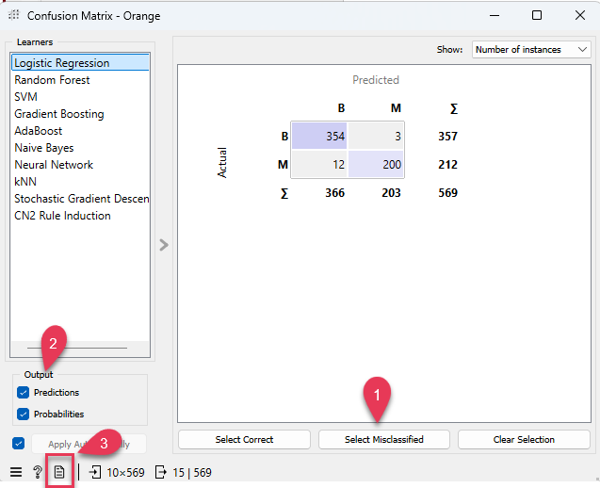
Model Evaluation – Confusion Matrix
Shows proportions between the predicted and actual class
1. Select: output data
- Correct data
- Misclassified data
- None
2. Add predictions and probabilities in the output
3. Produce a report
Notes:
Thank you!
Got Questions?

Slide 18
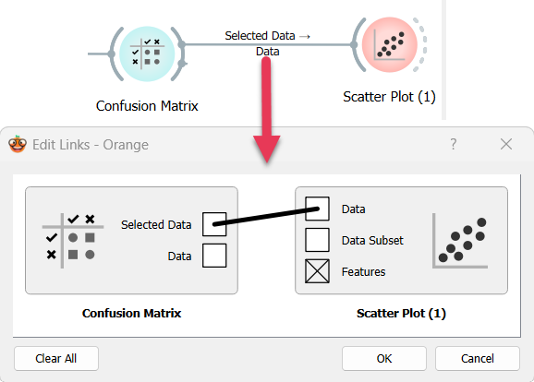
Links
Links between two widgets can transfer objects from the one widget to the other widget.
Classifier
Learner or Model
Data
Predictions
Objects
KNIME uses different types of nuggets but Orange uses Links

Slide 19
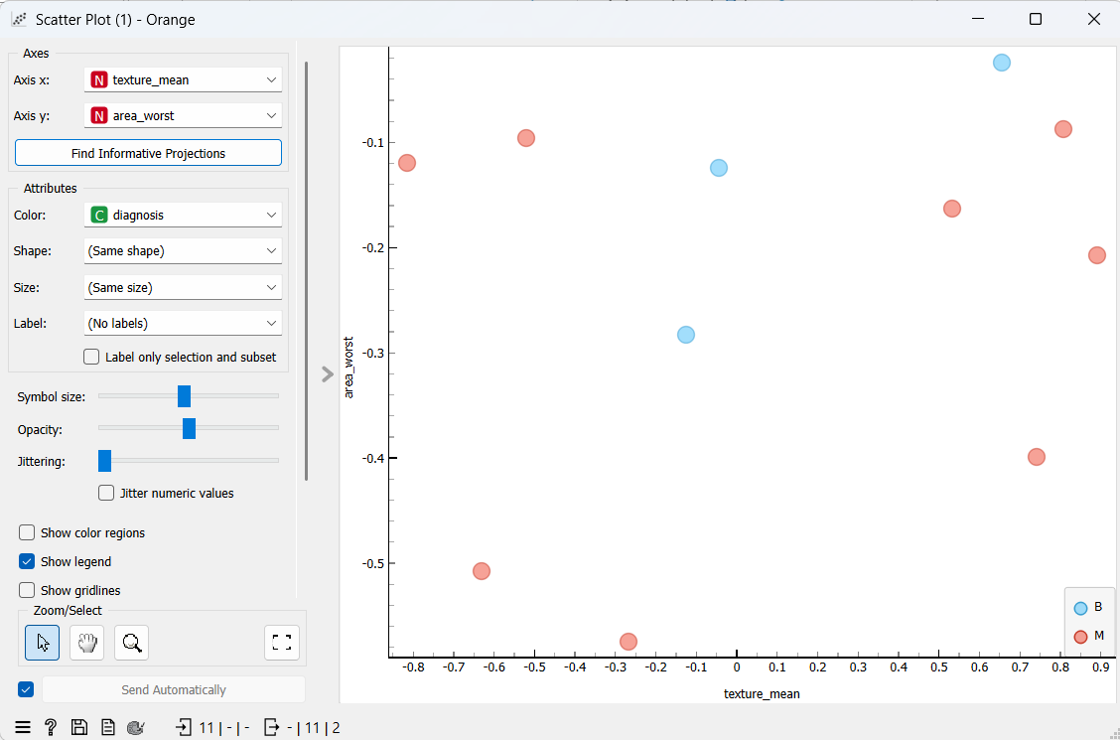
Model Evaluation – Scatter plot
Scatter plot: visually show misclassified the observations by x and y variables.
Notes:
Thank you!
Got Questions?

Slide 20
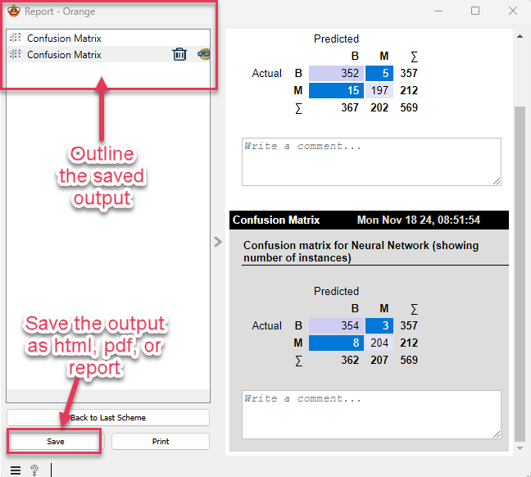
Report
Each widget has a report button in the status bar at the bottom.
Click Once!
Notes:
Thank you!
Got Questions?

Slide 21
Performance Curve
Analyze the proportion of true positive data instances in relation to the classifier's threshold or the number of instances that we classify as positive. lift curve, cumulative gains, and precision-recall curve.
Lift curve shows the ratio between lift (the proportion of true positive instances to all positive instances in the prediction) and the proportion of positive instances. The higher the initial curve and the longer it is flat, the better the model.
Cumulative gains chart shows the ratio of true positive instances and support, which is the fraction of positively predicted instances, assuming that the instances are ordered according to the model's probability of being positive (e.g. how likely the person has the disease). The greater the area between the curve and the baseline (dashed diagonal line), the better the model.
Precision-recall curve shows the ratio between precision (ratio of true positives in positive predictions) and recall (ratio of true positives in positive class) at different thresholds. Ideally one aims at a high area under the curve.
Notes:
shows the ratio of true positive instances and support, which is the fraction of positively predicted instances (the ratio of patients with a heart disease in the prediction), assuming that the instances are ordered according to the model's probability of being positive (e.g. how likely the person has the disease). The greater the area between the curve and the baseline (dashed diagonal line), the better the model.
(for example, people with heart disease)

Slide 22
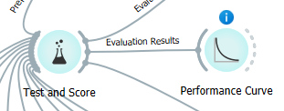
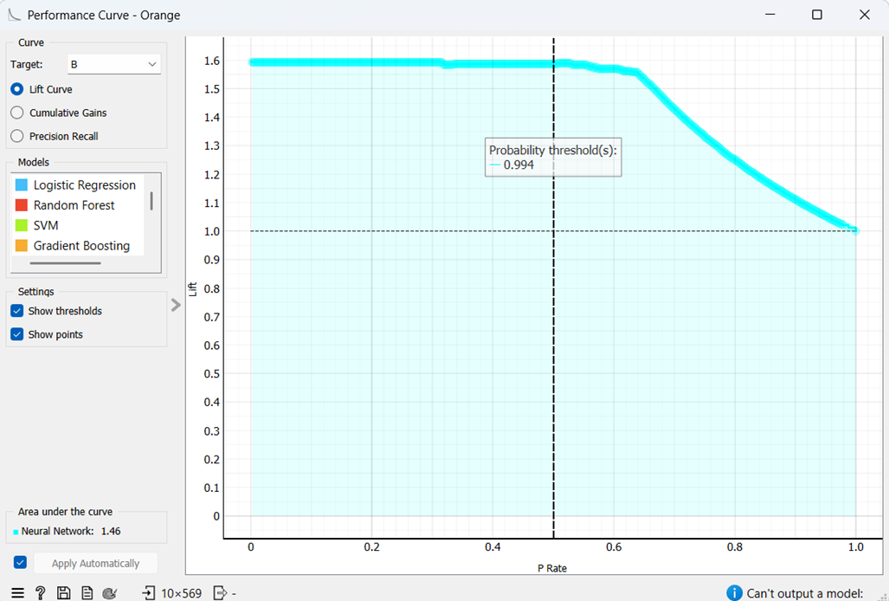
Performance Curve
Notes:
Thank you!
Got Questions?

Slide 23
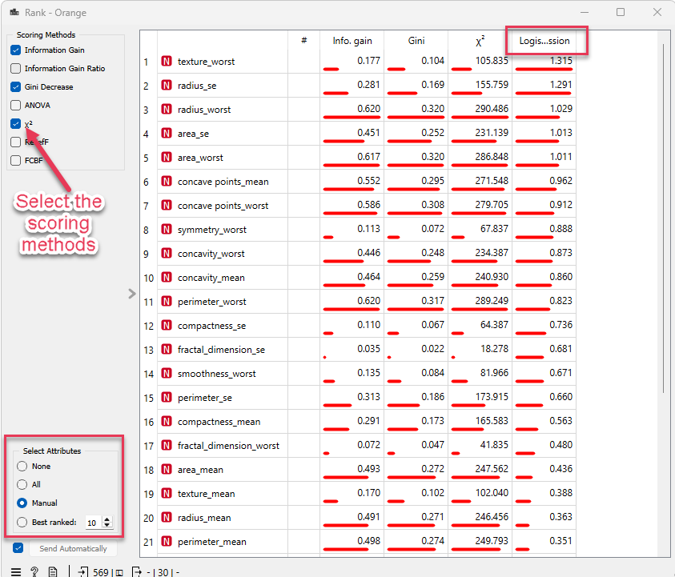
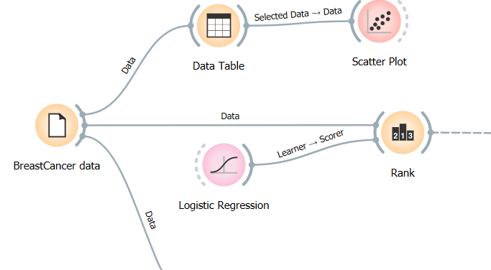
ML Variable Selection – Rank (1 of 2)
Rank scores variables according to their correlation with discrete or numeric target variable, based on applicable internal scorers (like information gain, chi-square and linear regression) and any connected external models that supports scoring.
Notes:
Select 10 variables rerun the model with 10 variabels

Slide 24
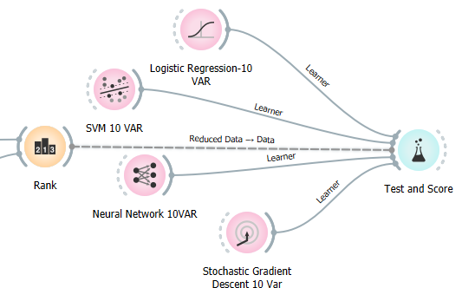
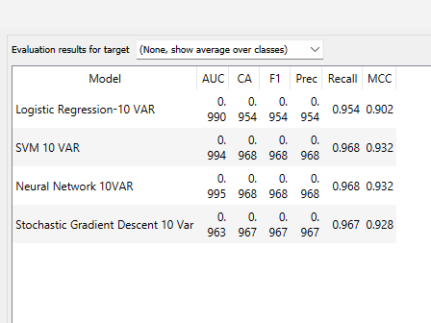
ML Variable Selection – Rank (2 of 2)
Fit 4 ML models using first 10 selected variables
Notes:
Select 10 variables rerun the model with 10 variabels

Slide 25
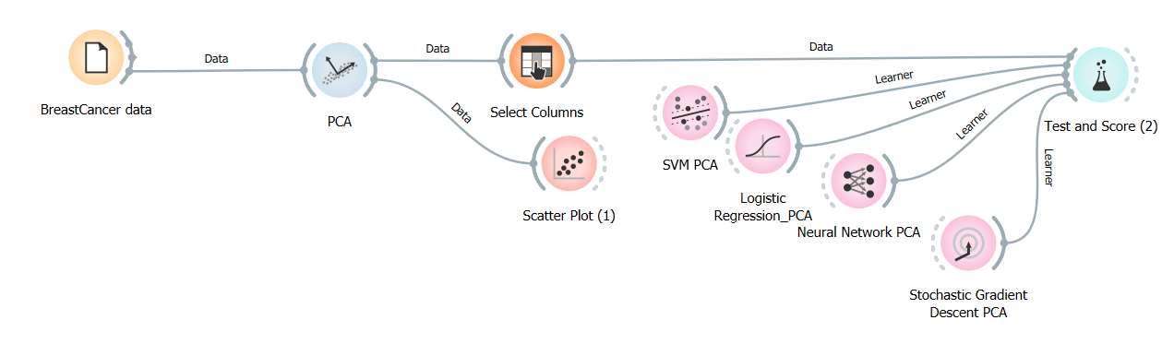
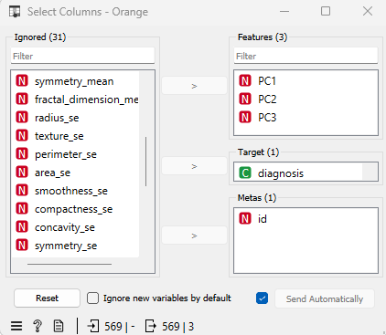
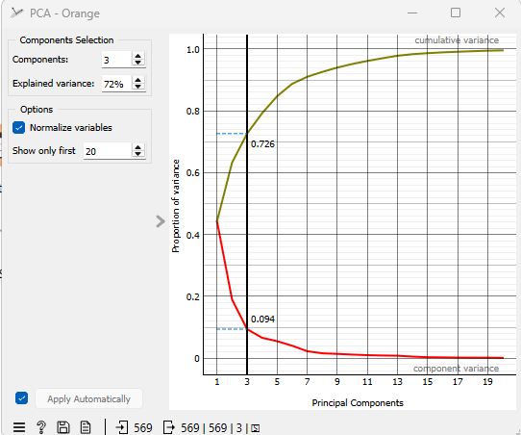
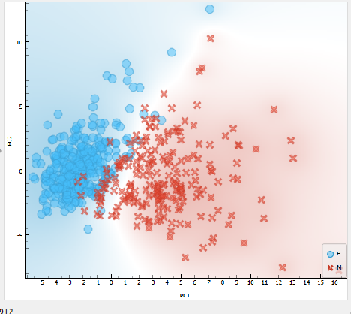
Principle Component Analysis (1 of 2)
PCA-> Select Columns (3PCA) -> Fit models -> Test and Score
Notes:
Thank you!
Got Questions?

Slide 26
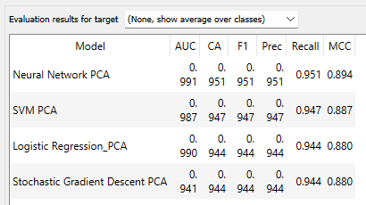
Principle Component Analysis
PCA-> Select Columns (3PCA) -> Fit models -> Test and Score
Notes:
Thank you!
Got Questions?

Slide 27
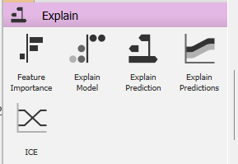
Add-on: Explain
Orange3 Explain is an add-on for the Orange3 data mining suite. It provides extensions for explanatory AI. (See more).
Option-> add-ons->Explain
Features
Explains a classification or regression model. Explains which features contribute the most and how they contribute toward the prediction for a specific class.
Explains which features contribute the most to the prediction for a single instance based on the model and how they contribute.
Notes:
Additional features can be added to Orange by installing
add-ons. You can find add-on manager in Options menu.
Explain Model widget explains classification and regression models with SHAP library. The widget gets a trained model and reference data on input. It uses the provided data to compute the contribution of each feature toward the prediction for a selected class.

Slide 28
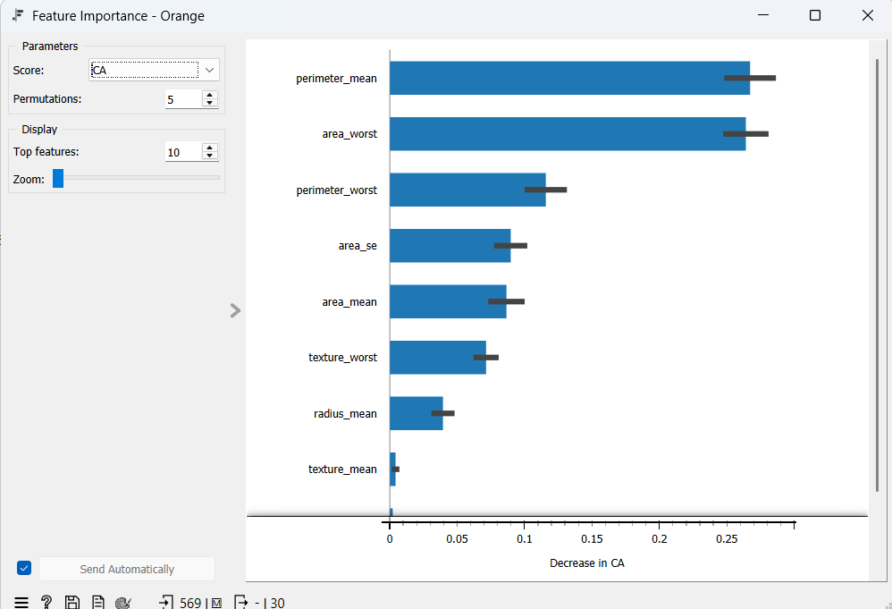
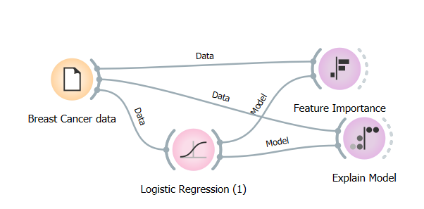
Feature Importance
Option-> add-ons->Explain
Compute the contribution of each feature toward the prediction, by measuring the increase in the prediction error of the model after we permuted the feature's values, which breaks the relationship between the feature and the target.
Notes:
Additional features can be added to Orange by installing
add-ons. You can find add-on manager in Options menu.
Explain Model widget explains classification and regression models with SHAP library. The widget gets a trained model and reference data on input. It uses the provided data to compute the contribution of each feature toward the prediction for a selected class.

Slide 29
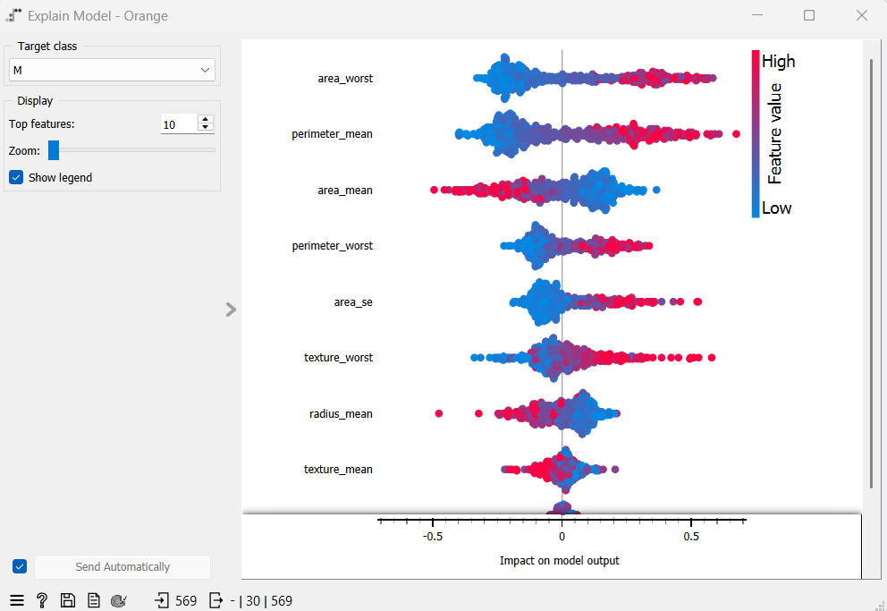
Explain Model
Explain Model: explains classification and regression models with SHAP library. SHAP value is a measure of how much each feature affect the model output. The highest ranked variable are perimeter mean and area_worst (the worst areas)- the variables with the highest impact on the prediction. Having a higher value in area_worst (red dots on the right) means the tumor is likely to be M.
Notes:
Additional features can be added to Orange by installing
add-ons. You can find add-on manager in Options menu.
Explain Model widget explains classification and regression models with SHAP library. The widget gets a trained model and reference data on input. It uses the provided data to compute the contribution of each feature toward the prediction for a selected class.

Slide 30
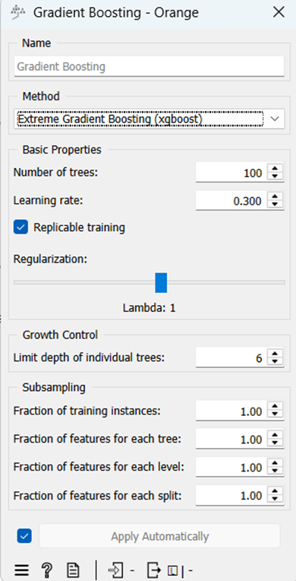
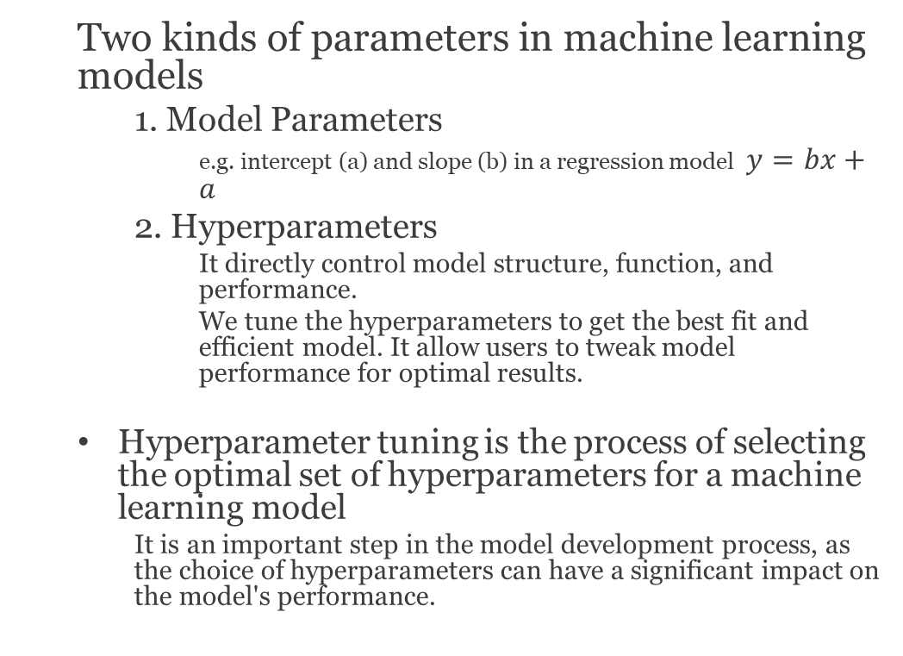
Hyperparameter Tuning
Two kinds of parameters in machine learning models
1. Model Parameters
e.g. intercept (a) and slope (b) in a regression model $y=bx+a$
2. Hyperparameters
It directly control model structure, function, and performance.
We tune the hyperparameters to get the best fit and efficient model. It allow users to tweak model performance for optimal results.
Hyperparameter tuning is the process of selecting the optimal set of hyperparameters for a machine learning model
It is an important step in the model development process, as the choice of hyperparameters can have a significant impact on the model's performance.
Notes:
The model parameters are drived from machine learning models. For example, if we think about a linear regression model, we have the parameters such as a and b, b is the slope and c is the intercept. So a and b values are drived from the dataset.
For example, assume you're using the learning rate of the model as a hyperparameter. If the value is too high, the model may converge too quickly with suboptimal results. Whereas if the rate is too low, training takes too long and results may not converge. A good and balanced choice of hyperparameters results in accurate models and excellent model performance.

Slide 31
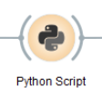
What are the hyperparameter tuning techniques?
5 Hyperparameter Optimization Techniques
Manual Search
Manually selects and adjusts the hyperparameters of the model
Grid Search
Random Search
Bayesian Optimization
Hyperband
Python Script
Reference: https://www.run.ai/guides/hyperparameter-tuning or
https://scikit-learn.org/1.5/modules/grid_search.html
Notes:
KNIME can do it using a node and set the parameters.

Slide 32
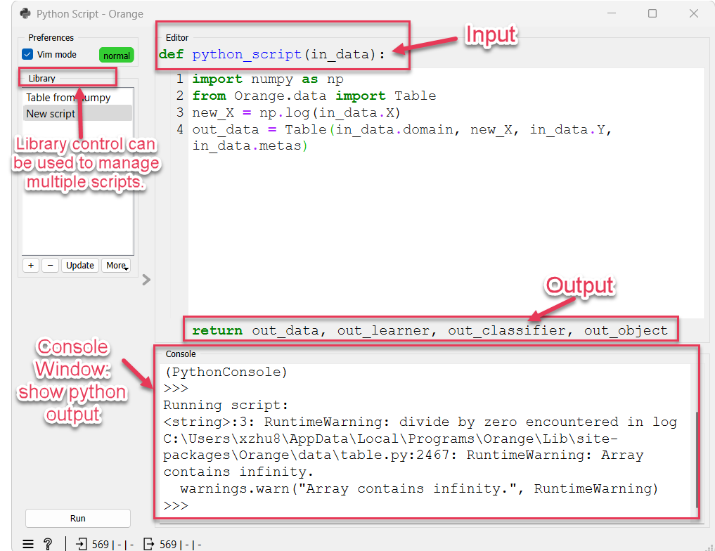
Hyperparameter Tuning - Python Script
When a suitable functionality is not implemented in an existing widget, we need to use Python Script
Python scripts: define a function with input parameters and output parameters.
Note: Learner is a model, like logistic regression. When we give a Learner a class-labeled dataset, the learner will return a classifier.

Slide 33
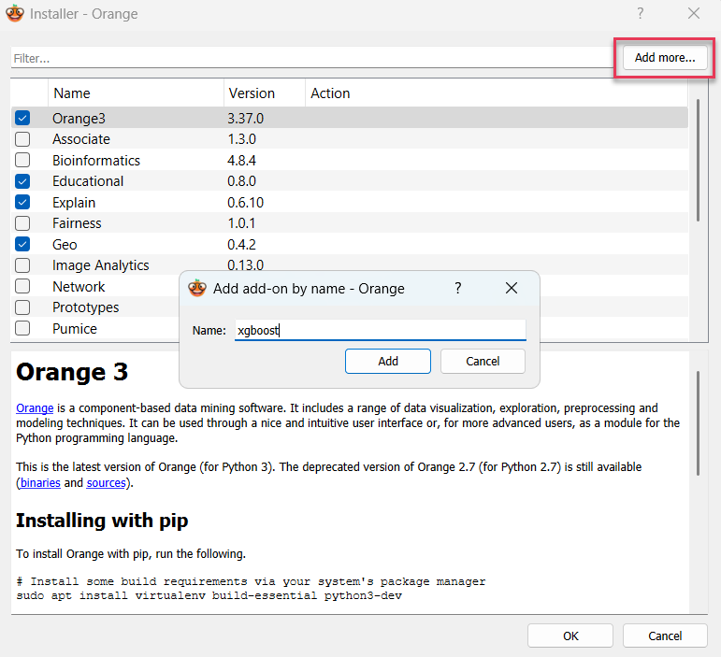
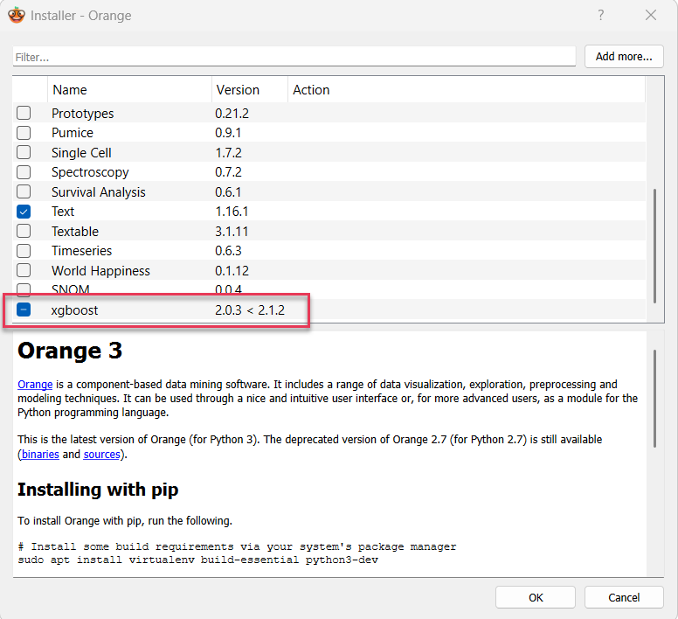
Install a Python Package in Orange3
Add-on -> Add more… ->Install xgboost package
Notes:
Thank you!
Got Questions?

Slide 34
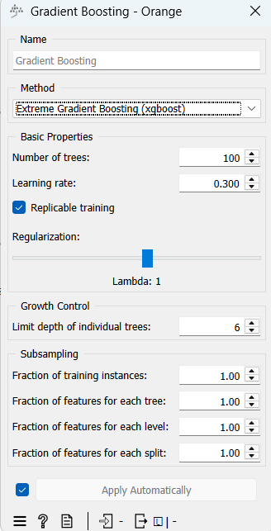
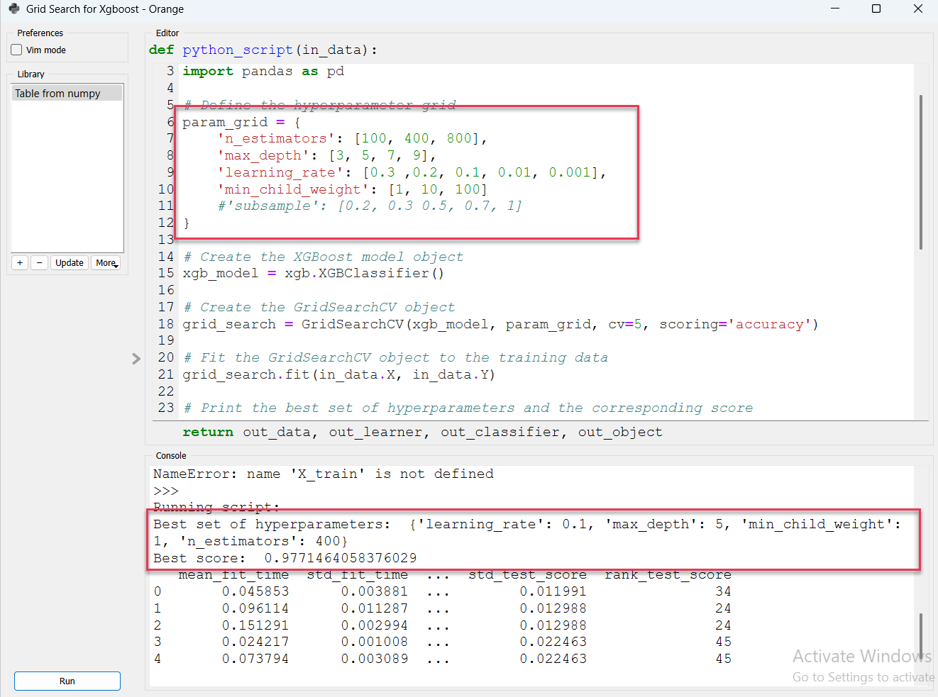
Hyperparameter Tuning-GridSearch
Sklearn – GridSearchCV to tune xgboost model
Notes:
KNIME ‘s best model is 0.973

Slide 35
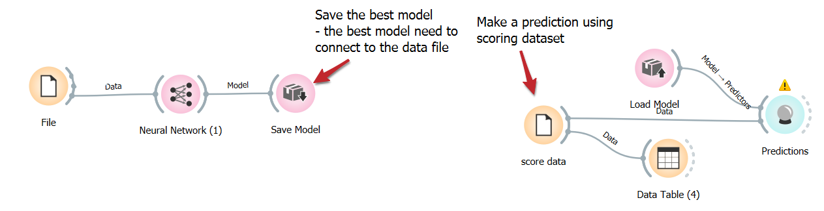
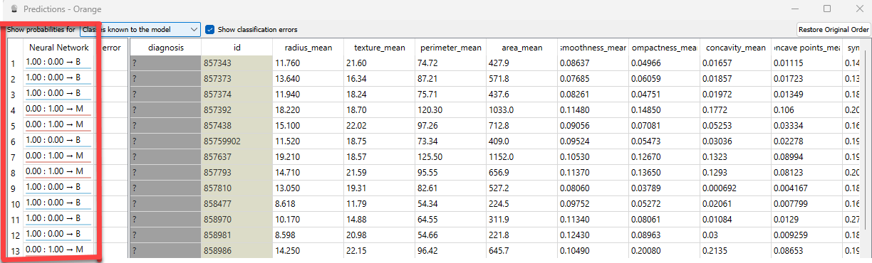
Make Predictions Using Scoring Data
Two ways to make a prediction
Save the best model, then load the model and make predictions
Use the best model and make prediction directly – See Regression
Notes:
Thank you!
Got Questions?

Slide 36
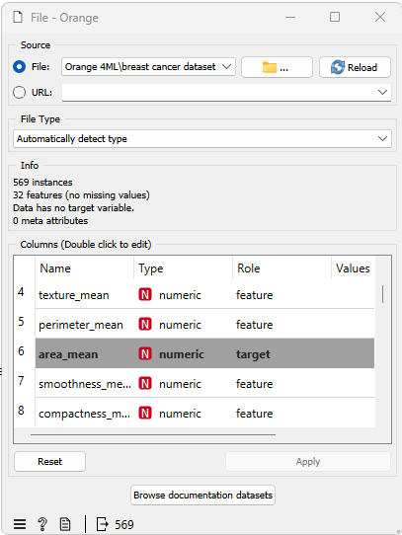
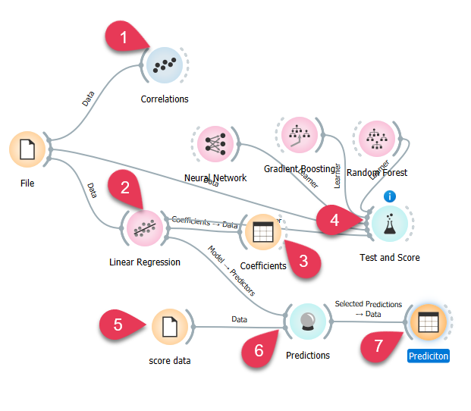
Example 2: Numeric Target
Set area_mean as target variable (y).
Notes:
Thank you!
Got Questions?

Slide 37
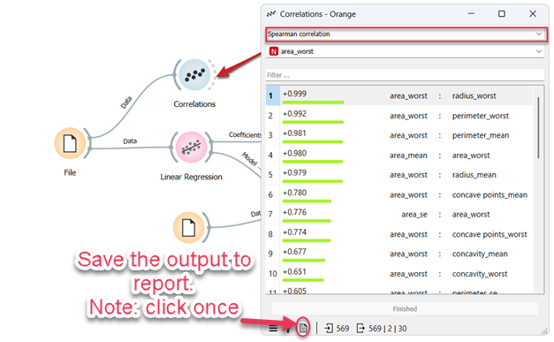
Correlations
Show Pearson or Spearman correlation with area_mean. You can also pick the other variables for correlations, e.g. area_worst.
Click report to save the output
Notes:
Thank you!
Got Questions?

Slide 38
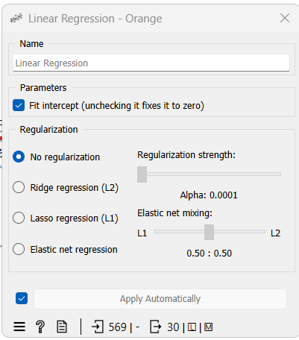
Fit a Regression Model
Fit a regression model with options
Parameters: Fit intercept.
Unchecking the option forces the intercept to 0.
Choose a model to train:
no regularization
a Ridge regularization (L2-norm penalty)
a Lasso bound (L1-norm penalty)
an Elastic net regularization
Notes:
Thank you!
Got Questions?

Slide 39
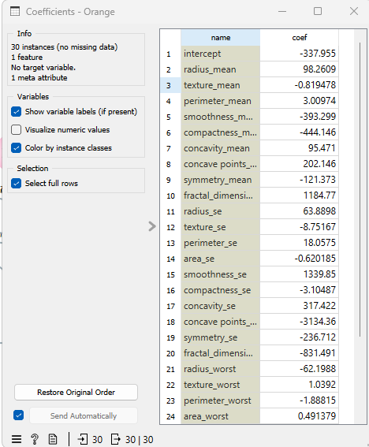

Fit a Regression Model
Data Table to view coefficients
No p-values for each variable
Test and score to view MSE RMSE andR2
Notes:
Thank you!
Got Questions?

Slide 40


Predict the Scoring Dataset
Set area_mean as target
Connect prediction with regression and score data
Performance scores are shown at the bottom
Table Data to view selected or all predicted values
Notes:
Thank you!
Got Questions?

Slide 41
Unsurprised Learning
When dealing with real-world problems, most of the time, data will not come with predefined labels, but we still want to develop machine learning models that can correctly classify the data by finding some commonality in the features to predict the classes on new data.
Two main types of problems in unsupervised learning:
Clustering
Dimension Reduction--PCA
Notes:
Thank you!
Got Questions?

Slide 42

Clustering Analysis
Cluster analysis or clustering is to group a set of objects that objects in the same group (called a cluster) are more similar (in some sense) to each other than to those in other groups (clusters).
Notes:
Thank you!
Got Questions?

Slide 43
Clustering
Clustering, however, has many different names (with respect to the fields it is being applied):
Cluster analysis
Automatic classification
Data segmentation
All the above names essentially mean clustering.
Cluster analysis have an incredible wide range of applications and are quite useful to solve real world problems such as anomaly detection, recommending systems, documents grouping, or finding customers with common interests based on their purchases. Some of the most common clustering algorithms will be explored in the workshop, are:
K-Means
Hierarchical Clustering
Notes:
Thank you!
Got Questions?

Slide 44

Hierarchical Clustering
Breast Cancer dataset
Distances computes distances between rows or columns in a dataset. By default, the data will be normalized to ensure equal treatment of individual features. Normalization is always done column-wise.
Notes:
Thank you!
Got Questions?

Slide 45

View distance: How?
Silhouette score
Notes:
The silhouette score is a measure of how similar an object is to its own cluster in comparison to other clusters and is crucial in the creation of a silhouette plot. The silhouette score close to 1 indicates that the data instance is close to the center of the cluster and instances possessing the silhouette scores close to 0 are on the border between two clusters.

Slide 46

Dendrogram
Three different selection methods:
Manual: clicking inside the dendrogram will select a cluster. Multiple clusters can be selected by holding Ctrl/Cmd. Each selected cluster is shown in a different color and is treated as a separate cluster in the output.
Height ratio: clicking on the bottom or top ruler of the dendrogram places a cutoff line in the graph. Items to the right of the line are selected.
Top N: selects the number of top nodes. Top N: 2 – two clusters
Notes:
Thank you!
Got Questions?

Slide 47


View Clusters-MDS and Box Plot
Multidimensional scaling (MDS) is a technique which finds a low-dimensional (in our case a two-dimensional) projection of points, where it tries to fit distances between points as well as possible.
Notes:
Thank you!
Got Questions?

Slide 48


K-means Clustering
Silhouette scores shows 2 is the best # of cluster
The higher the silhouette score, the better the clustering.
Preprocessing: If the option is selected, columns are normalized (mean centered to 0 and standard deviation scaled to 1).
Initialization method (the way the algorithm begins clustering)
Notes:
Initialization method (the way the algorithm begins clustering):
k-Means++ (first center is selected randomly, subsequent are chosen from the remaining points with probability proportioned to squared distance from the closest center)
Random initialization (clusters are assigned randomly at first and then updated with further iterations)
Re-runs (how many times the algorithm is run from random initial positions; the result with the lowest within-cluster sum of squares will be used) and
Maximum iterations (the maximum number of iterations within each algorithm run) can be set manually.

Slide 49



View Clusters
MDS and Scatter plot
MDS
Scatter Plot
Notes:
Thank you!
Got Questions?

Slide 50
Summary
Pros
Open-source library
User friendly and easy implement– visualize the data, ML procedures and interact with models
Useful documentations, tutorials and examples
Good for beginner or education purpose usage
Many add-ons and still in development
Fast computation speed
Cons
Still has a lot of limitations (e.g. feature (domains and table), no built in Karas package, and not for large dataset)
Python script console is hard to visualize the output. Jupyter notebook or spyder will be better to view the python commands and outputs
Orange2.7 still available but not be included in Orange3
Orange2.7 contains Hyperparameter tuning, but Orange3 does not and cannot run hyperparameter tuning in Orange3
Not for Advanced user. Some user says “Real life work is not like that, these tools (Orange) are just not enough.”
Notes:
Thank you!
Got Questions?

Slide 51
Thank You!
For more information visit Orange3 website at:
https://orange3.readthedocs.io/projects/orange-visual-programming/en/latest/index.html
To request RCS services, call the HelpDesk at:
865-974-9900
Questions?
Notes:
Thank you!
Got Questions?

